Slide 1
WANDERLUST:A PERSONALIZED TRAVEL PLANNING AND TRACKING APP
By
TAMIL SELVI .S
AKILA.B
ARULKUMAR.A
BAVAN.R]

Slide 2
PROJECT DESCRIPTION:
The Personalized Travel Planning and Tracking App aims to provide travelers with a tailored, streamlined experience for planning, organizing, and tracking their trips.
By leveraging user preferences, real-time data, and AI-driven recommendations, the app will assist users in planning the best travel itineraries, booking accommodations, and navigating destinations.
Additionally, the app will offer tracking features to help users keep tabs on their travel progress, manage logistics, and document their journey in a personalized, seamless manner.

Slide 3
KEY FEATURES:
Personalized Trip Planning:
  Profile Setup: Users can create a profile with preferences such as travel style (e.g., adventure, luxury, budget), interests (e.g., history, nature, food), and past travel experiences.
  Destination Recommendations: Based on user preferences, the app suggests personalized destinations, attractions, and activities.
  Custom Itinerary Builder: A dynamic itinerary builder that helps users create their daily travel schedules by adding activities, transport options, and accommodations.
Smart Booking & Reservations:
  Accommodation Booking: Integrate with various travel partners (e.g., Booking.com, Airbnb) for hotel and lodging options.
  Activity & Experience Booking: Users can book local tours, events, or experiences through the app, with recommendations tailored to their preferences.
  Transport Planning: Plan flights, trains, buses, or car rentals with real-time availability and booking options.
Real-Time Travel Tracking & Updates:
  Flight & Transport Status: Real-time tracking of flight statuses, train schedules, and local transportation updates.
  GPS Navigation: Integrated maps and navigation for walking, driving, and public transit.
  Expense Tracker: Monitor travel expenses, budgeting alerts, and exchange rates for seamless financial management during the trip.

Slide 4
Travel Journal & Memory Sharing:
  Digital Travel Journal: Users can document their journey by taking notes, uploading photos, and recording their experiences day-by-day.
  Social Integration: Share highlights of the trip on social media platforms, or with fellow travelers using in-app sharing features.
  Collaborative Planning: Allows multiple users to contribute to planning and documenting group trips, with shared itineraries and notes.
Local Insights & Recommendations:
  AI-Driven Suggestions: Personalized activity suggestions based on location, user preferences, and travel history.
  Local Tips: Provide users with insights from locals, including hidden gems, safety tips, and cultural advice.
  Weather and Safety Alerts: Real-time weather updates, and safety alerts or recommendations based on current conditions.
Seamless Integration with Existing Travel Tools:
  Third-party App Integrations: Sync with Google Calendar, flight booking sites, and hotel booking services.
  Document Storage: Store travel-related documents such as itineraries, tickets, and passports securely within the app.

Slide 5
MAIN ACTIVITY: package com.example.travelapp import android.content.Context import android.content.Intent import android.os.Bundle import androidx.activity.ComponentActivity import androidx.activity.compose.setContent import androidx.compose.foundation.Image import androidx.compose.foundation.clickable import androidx.compose.foundation.layout.* import androidx.compose.foundation.rememberScrollState import androidx.compose.foundation.verticalScroll import androidx.compose.material.Card import androidx.compose.material.Text import androidx.compose.runtime.Composable import androidx.compose.ui.Alignment import androidx.compose.ui.Modifier import androidx.compose.ui.draw.scale import androidx.compose.ui.graphics.Color import androidx.compose.ui.res.painterResource import androidx.compose.ui.res.stringResource import androidx.compose.ui.text.font.FontFamily import androidx.compose.ui.text.font.FontWeight import androidx.compose.ui.text.style.TextAlign import androidx.compose.ui.unit.dp import androidx.compose.ui.unit.sp

Slide 6
class MainActivity : ComponentActivity() {
override fun onCreate(savedInstanceState: Bundle?) { super.onCreate(savedInstanceState)
setContent {
TravelApp(this)
}
}
@Composable
fun TravelApp(context: Context) {
Column(
modifier = Modifier
.padding(20.dp)
.verticalScroll(rememberScrollState()) ) {
Text( fontSize = 40.sp,
color = Color(android.graphics
.Color.rgb(120, 40, 251)), fontFamily = FontFamily.Cursive, text = "Wanderlust Travel" )
Spacer(modifier = Modifier.height(20.dp)) //
01

Slide 7
Card( modifier = Modifier
.fillMaxWidth() .height(250.dp) .clickable { context.startActivity
( Intent(context, BaliActivity::class.java) ) },
elevation = 8.dp )
{
Column( horizontalAlignment = Alignment.CenterHorizontally )
{ Image( painterResource(id = R.drawable.bali),
contentDescription = "", modifier = Modifier .height(150.dp)
.scale(scaleX = 1.2F, scaleY = 1F)
)
Text
( text = stringResource(id = R.string.place_1),
fontSize = 18.sp ) Text( text = stringResource(id = R.string.description),
fontWeight = FontWeight.Light,
fontSize = 16.sp, textAlign = TextAlign.Center, )
Text( text = stringResource(id = R.string.plan),
color = Color.Gray, fontSize = 16.sp
) }
} Spacer(modifier = Modifier.height(20.dp)) //02

Slide 8
Card( modifier = Modifier .fillMaxWidth()
.height(250.dp)
.clickable { context.startActivity( Intent(context, ParisActivity:
:class.java)
) }, elevation = 8.dp )
{ Column( horizontalAlignment = Alignment.CenterHorizontally )
{
Image( painterResource(id = R.drawable.paris), contentDescription = "", modifier = Modifier
.height(150.dp)
.scale(scaleX = 1.2F, scaleY = 1F)
) Text( text = stringResource(id = R.string.place_2),
fontSize = 18.sp )
Text( text = stringResource(id = R.string.description), fontWeight = FontWeight.Light, fontSize = 16.sp, textAlign = TextAlign.Center, )
Text( text = stringResource(
id = R.string.plan), color = Color.Gray,
fontSize = 16.sp )
}
}

Slide 9
Spacer(modifier = Modifier.height(20.dp)) //03 Card( modifier = Modifier
.fillMaxWidth()
.height(250.dp)
.clickable { context.startActivity( Intent(context, SingaporeActivity::class.java)
) }, elevation = 8.dp )
{ Column( horizontalAlignment = Alignment
.CenterHorizontally )
{ Image( painterResource(id = R.drawable.singapore), contentDescription = "", modifier = Modifier
.height(150.dp) .scale(scaleX = 1.2F,scaleY = 1F)
) Text( text = stringResource(id = R.string.place_3),
fontSize = 18.sp )
Text( text = stringResource(id = R.string.description), fontWeight = FontWeight
.Light, fontSize = 16.sp,
textAlign = TextAlign.Center,
)
Text( text = stringResource(id = R.string.plan), color = Color.Gray, fontSize = 16.sp ) } } Spacer(modifier = Modifier.height(20.dp))
}
}
}

Slide 10
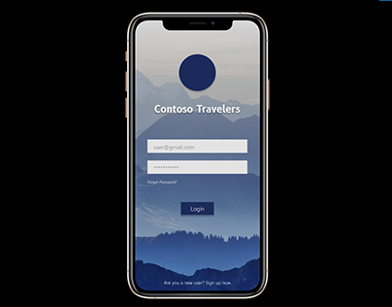
OUTPUT

Slide 11

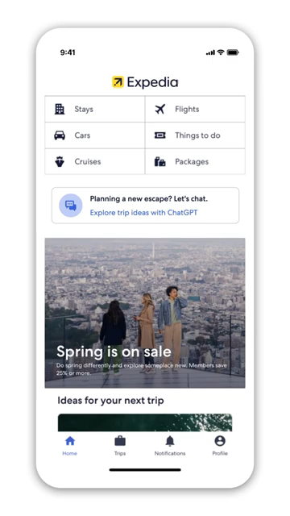
Demo video

